Slide 1
Telecom Churn Case
Study
Archana Lahiri
Chand Pasha
Bijal Dave

Slide 2
Problem Statement
Customers in the telecom sector have access to a variety of service providers and can actively switch from one operator to another. The telecoms business has an average annual churn rate of 15 to 25 percent in this fiercely competitive market. Customer retention has now surpassed customer acquisition in importance due to the fact that it is 5–10 times more expensive to gain new customers than to keep existing ones. Retaining highly profitable consumers is the top business objective for many established operator. Analysis needs to be done to predict models to find customers who are likely to leave
Analysis needs to be done for Prepaid and Postpaid model. The Churn is more critical for Prepaid
Customers in India and Southeast Asian Market.
There are 2 types of churn Revenue based churn and Usage based churn. We need to do analysis on the usage based definition to define churn. The business objective is to predict the churn in the last (i.e. the ninth) month using the data (features) from the first three months.
There are 3 phases of customer Good, Action and Churn. Churn is defined during the last phase as mentioned and data is discarded corresponding to the tag churned.

Slide 3
Analyses Approach
Reading and understanding the data
Data Cleaning
Filtering the High Value Customer
Defining Target Variable
Data Preparation
Data Modelling
Creating dummies
Train- Test split
Handling Class Imbalance
Logistic Regression
RFE technique for variable selection
Model Building
Model Evaluation – Accuracy, Specificity, Sensitivity
Predicting on test data
Hyperparameter Tuning
Model Selection

Slide 4
Data Understanding and Cleaning
The dataset telecom_churn_data.csv has around 99999 entries with 226 attributes
The missing values are imputed accordingly for data recharge ,count recharge columns
Dropping columns/rows with high missing values.
Feature Engineering to create new columns

Slide 5
Filtering the High Value Customers and defining Target Variable
Imputing the attributes having missing values with advanced imputation technique like `KNNImputer’.
Two Types of Churn Usage Based churn “Completely inactive Customers” and Revenue Based Churn “Partial Inactive Customers”
9th month is the churn phase , Churn variable is derived using total_ic_mou_9`,`total_og_mou_9`,`vol_2g_mb_9` & `vol_3g_mb_9` attributes
Check for correlation of the independent variables and understand their
dependencies.

Slide 6
Data Preparation
▶ Deriving New Variables
▶ Verifying correlation between target variable (Sale Price) and other variable in the data frame.
▶ Visualization of data to view the churn rate.

Slide 7
Model Building
▶ Creating Dummy Variables for categorical variables
▶ Handling Class imbalance, using SMOTE method.
▶ Features are selected using RFE
▶ Model is formed using Logistic Regression
▶ By checking p value and vif values, features are dropped and optmal model is obtained
▶ Parameters like Accuracy, Specificity, Sensitivity are calculated
▶ Predictions are applied on Test data and evaluated

Slide 8
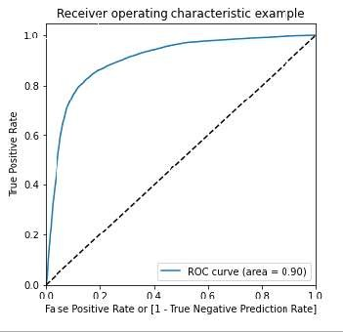
Model evaluation –ROC Curve
▶ ROC Curve

Slide 9
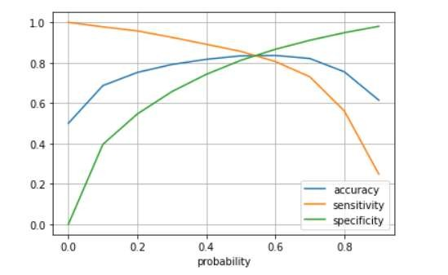
Model Evaluation-Accuracy
▶ Accuracy : 83.6
▶ Sensitivity :. 83.6
▶ Specific ity : 83.6
From the above graph, we can see the optimum cutoff is
around 0.54**

Slide 10
Model Evaluation on Test data
▶ Accuracy : 83
▶ Sensitivity :80.0
▶ Specific ity : 82.9
As the model created is based on a sensitivity model, i.e. the True positive rate is
given more importance as the actual and prediction of churn by a customer

Slide 11
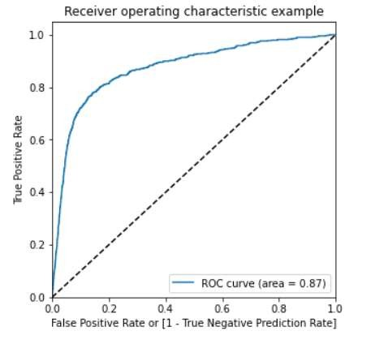
Model evaluation –ROC Curve
▶ ROC Curve
**The AUC score for train Data Frame is 0.90 and the test Data Frame is 0.87.This model can be considered
as a good model.**

Slide 12
PCA and SVM on Logistics Regression
▶ The Accuracy of the logistic regression model in train with PCA: 81.8
▶ Accuracy of the logistic regression model in test with PCA: 75.4
▶ SVM Analysis Below.
Accuracy 78.1
Precision 23.3
Recall 74.3

Slide 13
Hyper parameter Tuning
▶ The Test score is 86.9 corresponding to
hyper parameters {'C': 1000, 'gamma': 0.01}
▶ Random Forest Analysis Below.
Accuracy 93.2
Precision 73.8
Sensitivity/Recall 24.8
Roc_auc_score 62.0

Slide 14
Model Selection
▶ The best model out of al is Logistic regression model which gives recal of 81% and ROC value of 0.89

Slide 15
Inferences
▶ Accuracy, Sensitivity and Specificity are in similar range for Train and Test data
▶ Std Outgoing Calls and Revenue Per Customer are strong indicators of Churn.
▶ Local Incoming and Outgoing Cal s for 8th Month and avg revenue in 8th Month are the most important columns to predict churn.
▶ Customers with tenure less than 4 yrs are more likely to churn.
▶ Max Recharge Amount is a strong feature to predict churn.
▶ Logistic Regression produced the best prediction results after tackling
Class Imbalance

